Slide 1


Online Bug Tracking System

Slide 2
Our Team
Aditya Kejriwal
Aman Kumar
Atharva Soman
Durva Chavan
Nancy Biyahut
Soumil Agarwal
Sugandhi Arora
Satyam Jha
Aaron Loeb
Alfredo Torres
Juliana Silva
Daniel Gallego
Olivia Wilson
CEO & Founder
Project manager
CEO & Founder
IT Expert
Marketing Head

Slide 3

Online Bug Tracking System
Overview:
The Online Bug Tracking System is designed to simplify the process of tracking bugs, managing projects, and improving communication among team members.
It is essential for organizations to keep track of issues, monitor progress, and resolve bugs efficiently to maintain high-quality software development.
Objective:
To create a user-friendly platform that allows project managers, developers, and testers to collaborate seamlessly.
Provide role-based access to ensure that users only have access to the features they need.
Enhance the reliability and maintainability of software projects by effectively managing bug reports and project tasks.

Slide 4

Project Features
Multi-Role Support:
The system supports different user roles including Project Manager, Developer, and Tester, each with specific functionalities.
Bug Tracking:
Bugs can be logged, assigned, and tracked with detailed information including severity, status, and related comments.
Project Management:
Manage multiple projects with features to create, update, and monitor project progress.
Assign tasks to team members and track their completion status.
User Registration and Authentication:
Secure login mechanism with role-based access control.
Users must register with the system and are assigned specific roles that determine their access and permissions.
Exception Handling:
Custom exceptions such as DeveloperServiceLayerException, ensure robust error management and clear debugging.
Data Persistence:
The system uses SQL for data persistence, efficiently storing and retrieving information related to bugs, projects, and users.
DAO (Data Access Object) pattern is implemented to abstract and encapsulate all access to the data source.

Slide 5

Technical Stack
Backend:
Java: Core language used to implement the backend logic.
Exception Handling: Custom exceptions for handling specific error cases.
Frontend:
HTML, CSS, Javascript
Database:
SQL (e.g., MySQL, PostgreSQL): Used for persistent data storage and retrieval.
Libraries/Frameworks:
JDBC: Used for connecting and executing SQL queries in the database.
Tools:
IntelliJ IDEA/Eclipse: IDEs used for development.
Github: Version control system for managing codebase.
Maven/Gradle: Build tools for managing project dependencies and packaging.

Slide 6
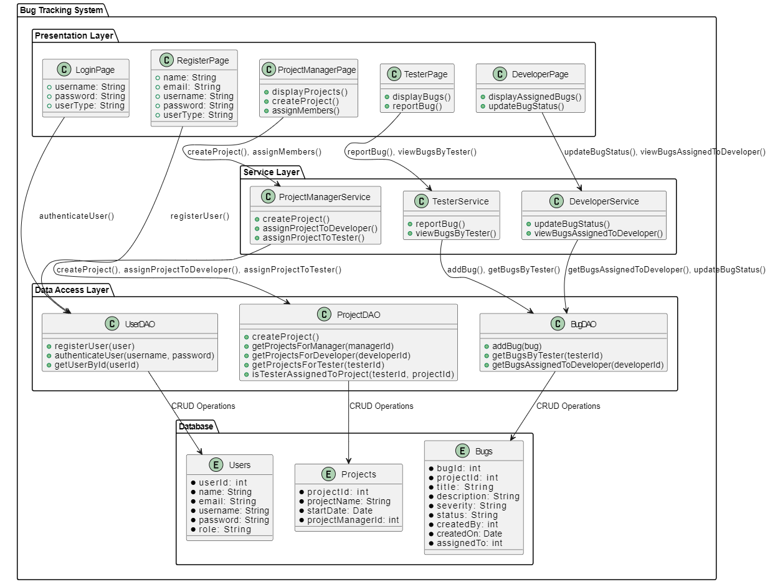
System Architecture

Slide 7

Challenges and Solutions
Challenge :
Handling multiple roles and ensuring that users only have access to the features they need.
Solution :
Implemented role-based access control, ensuring that each role (Project Manager, Developer, Tester) has access only to relevant features.
Challenge :
Efficiently handling database operations while ensuring that data integrity is maintained.
Solution :
Used the DAO pattern to separate business logic from data access logic, enhancing maintainability and scalability.
Challenge :
Implementing comprehensive error handling to provide meaningful error messages and avoid system crashes.
Solution :
Created custom exceptions and implemented try-catch blocks throughout the application to handle and log errors effectively.

Slide 8
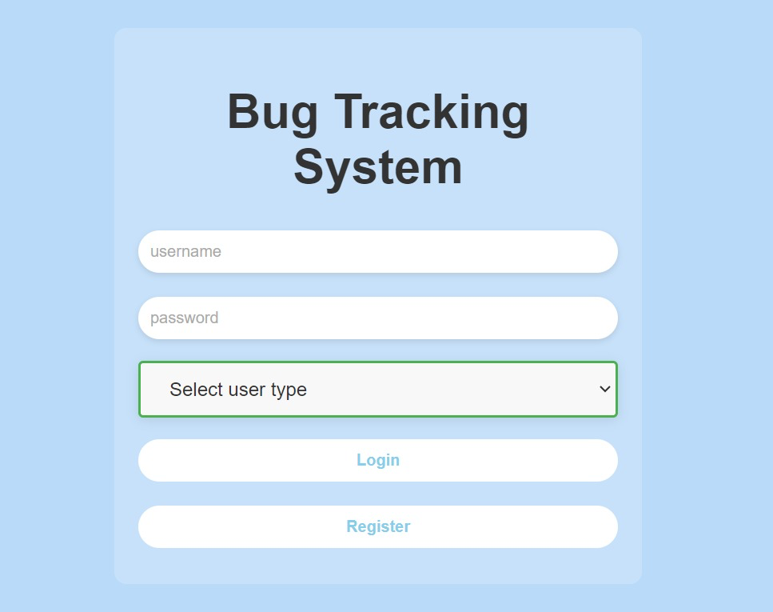
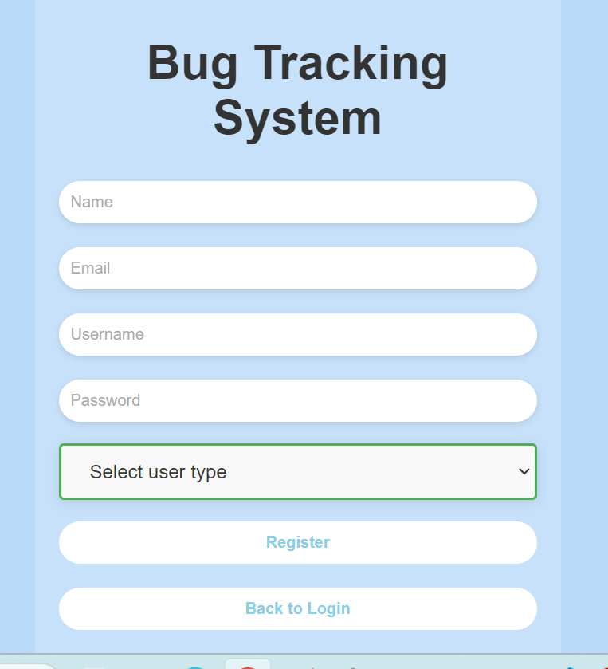
UI Snapshots
Login Page
Register Page

Slide 9
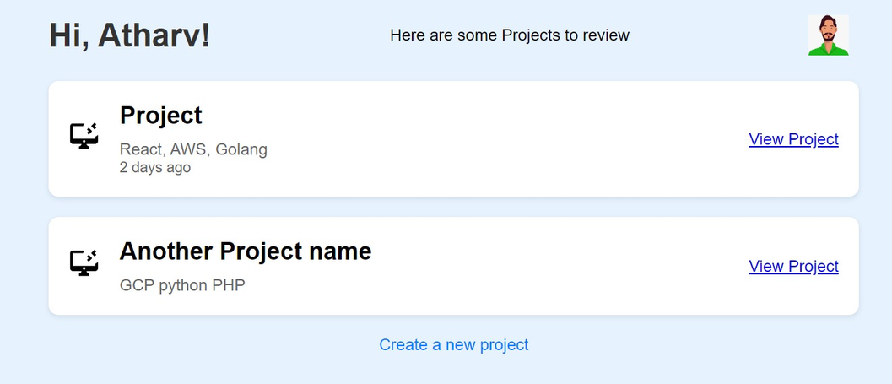
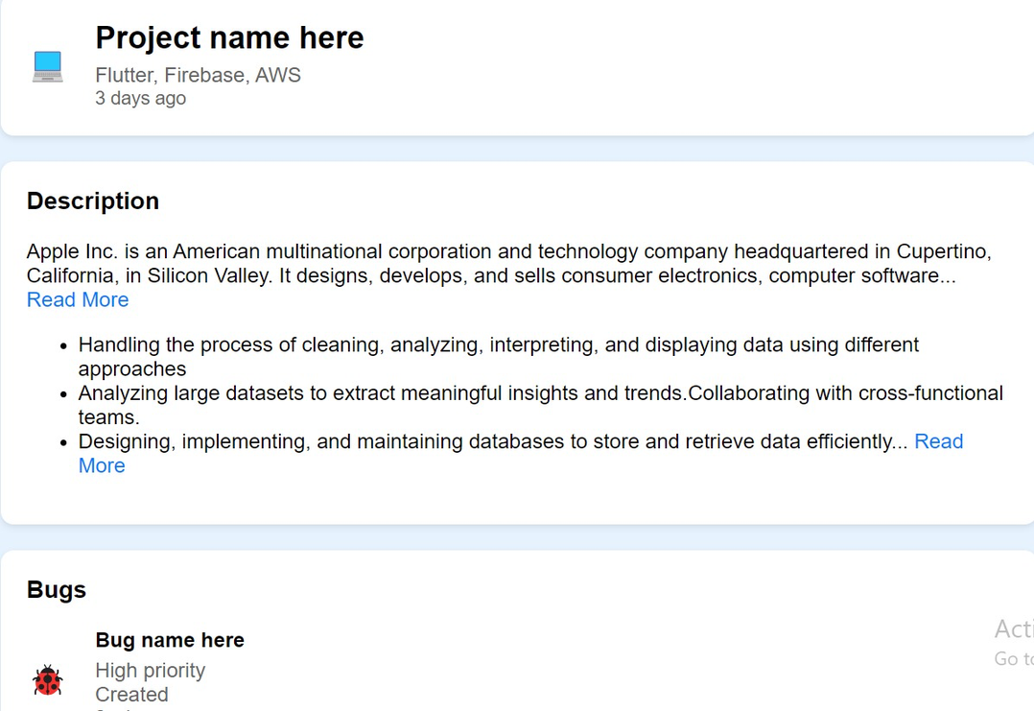
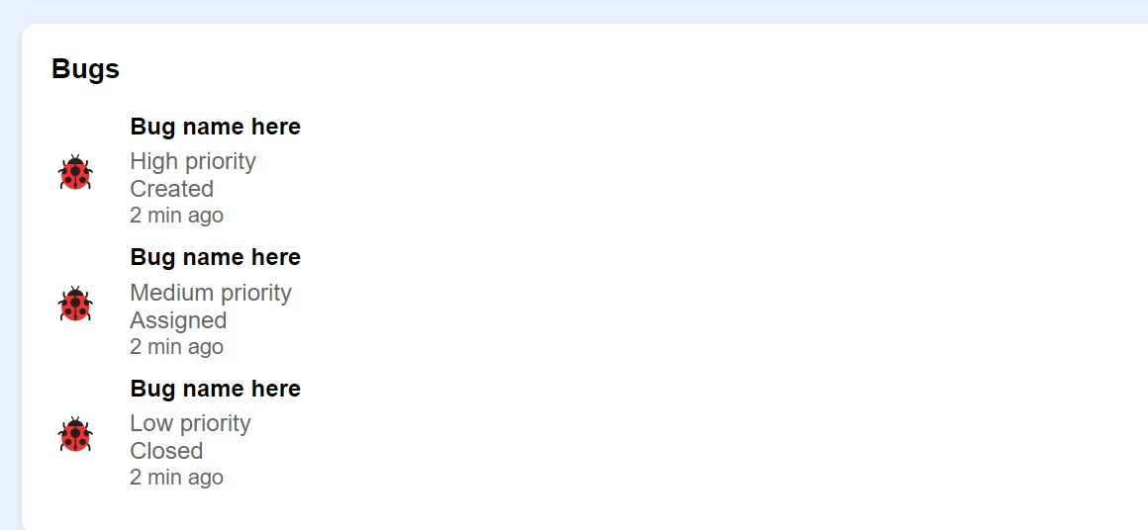
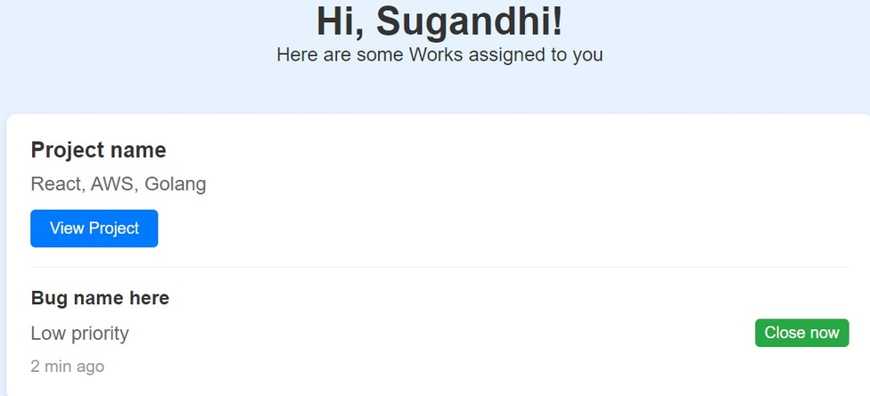
Project Manager Page
Developer page
Project Details Page

Slide 10
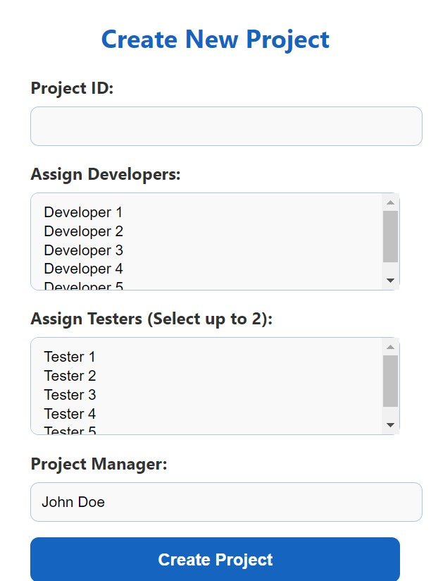
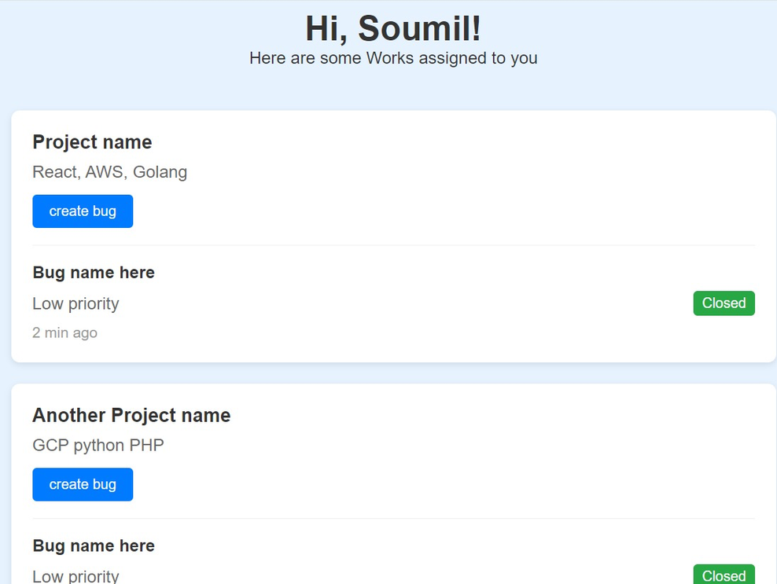
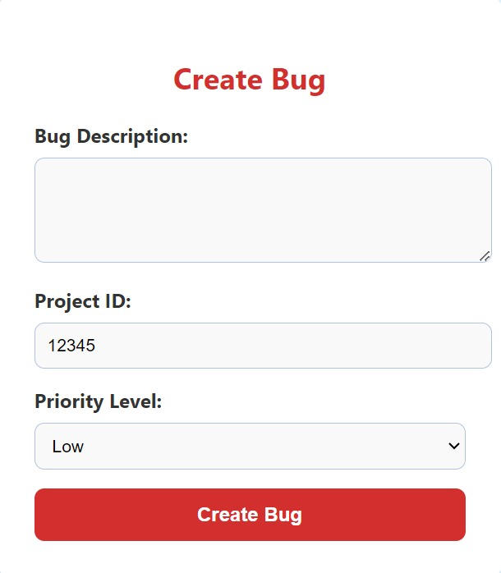
Create Project Form
Tester Home Page
create bug form

Slide 11

Learning Highlights
Technical Skills:
Gained deep knowledge of Java, including exception handling, DAO pattern, and service layer implementation.
Improved SQL skills, including writing efficient queries and managing database connections.
Problem-Solving:
Developed strong problem-solving skills, particularly in debugging and resolving complex issues related to user roles and database interactions.
Team Collaboration:
Enhanced team collaboration skills by working closely with peers on design decisions, code reviews, and integration tasks.

Slide 12


THANK YOU!

